Slide 1
Trauma-focused cognitive behavioral therapy (tf-cbt)
Cheryl L. Somers, Ph.D.
Michigan Certified School Psychologist
Michigan Licensed Psychologist (LP)

Slide 2
Origins of TF-CBT
Treatment Developers:
•Judith Cohen, M.D. & Anthony Mannarino, Ph.D.,
Center for Traumatic Stress in Children & Adolescents
Allegheny General Hospital
•Esther Deblinger, Ph.D., Rowen University
Medicine, CARES Institute
(Cohen, Mannarino, & Deblinger, 2006)

Slide 3
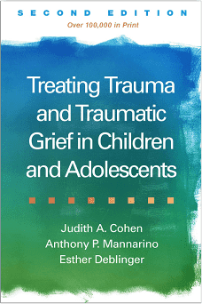
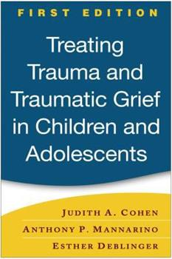
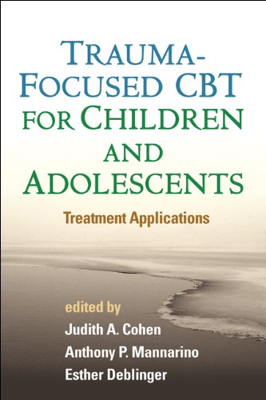
TF-CBT seminal texts
Cohen, Mannarino, & Deblinger (2006; 2017)
Treatment applications book in 2012

Slide 4
Prevalence of Child Trauma
• Approximately 60% of U.S. youth are exposed to trauma by age 18 (Finkelhor et al., 2010, 2015)
• Even higher in inner-city (up to 90% in an ER department)
• Through Our Eyes: Children, Violence, and Trauma
How trauma impacts– http://www.youtube.com/watch?v=z8vZxDa2KPM
Trauma types vary greatly!

Slide 5
Trauma Has Great Consequences!
Nearly all trauma survivors have acute distress
PTSD is common (average 20%; range = 10-35%)
Most eventually recover without treatment, but it can take long and be painful along the way, coping challenges can persist, etc.
But the impact, whether “recovered” or not, can last very long
Clearly, the impact varies greatly, but…..
Trauma in childhood linked to mental health and chronic disease in adulthood

Slide 6
Intervention Options
They include:
School-wide trauma-informed teaching
professional development for all
Individual teacher consultations
Group therapy approaches, often for kids inpatient
Individual therapy—Supportive therapy/humanistic, CBT, DBT—teaching acceptance, distress tolerance, etc., and others…. and TF-CBT!

Slide 7
Learning this technique
My current training…. expanding my skillset -- online modules, live training, 3 cases, 1 year supervision—to receive their “TF-CBT” certification/credential
Elissa J. Brown, Ph.D., Child HELP Partnership, St. John's University
Executive Director; HELP=Healing, Empowering, Learning, Public Education
http://www.childhelppartnership.org/
PI of $3M grant from SAMHSA (Substance Abuse and Mental Health Services Administration); mission, data collected, etc.
Partners include The National Child Traumatic Stress Network and
WSU clinical psych (Dr. Doug Barnett) -- one of many university partners recruiting trainees and gathering case/efficacy data.

Slide 8
Learning this technique
Elissa emphasizes in training….
Trauma is hard to discuss—your body may tell you to distract—even for mental health practitioners
But we have to be present to help (no phones, laptops)
• We have to take risks/struggle to hear trauma stories to really help
• There are trauma survivors everywhere (even in the room today) who may be triggered; Use sensitive language; Take breaks when needed

Slide 9
What is TF-CBT?
Cohen et al. (2006) developed this intervention to help traumatized children with PTSD and their non-offending caregivers.
The approach has spread world-wide.
Treatment is divided into three phases:
Learning coping skills (i.e., affect identification and regulation for children, affect regulation and parent training for caregivers),
Writing a trauma narrative, and
Holding conjoint sessions to share the narrative and develop ongoing safety plans.
Treatment is designed to reduce trauma-related mental health problems, including children’s PTSD, depression, and externalizing behavior problems

Slide 10
What is TF-CBT?
“Trauma-Focused Cognitive-Behavioral Therapy (TF-CBT) is an evidence-based, conjoint child and parent/caregiver psychotherapy model for children and adolescents who are experiencing clinically significant emotional and behavioral difficulties related to traumatic life events they have experienced. TF-CBT is a relatively brief (typically 12-20 sessions), components-based treatment model that incorporates interventions and techniques based on cognitive, behavioral, family therapy, and humanistic principles.”

Slide 11
Goals of TF-CBT
“The goals of TF-CBT are to enable children and youth who have experienced serious traumatic events, and their supportive caregivers, 1) to learn effective skills to cope with trauma-related emotional and behavioral problems, 2) to face and resolve those problems in a safe and therapeutic way, and 3) to effectively integrate their trauma experiences and help them move on with their lives in a safe and positive manner……

Slide 12
Goals of TF-CBT
“….Specifically, TF-CBT is designed to reduce symptoms of Posttraumatic Stress Disorder (PTSD), trauma-related depression, anxiety, and behavior problems, and common trauma-related cognitive and emotional problems such as fear, shame, embarrassment, guilt, and self-blame. TF-CBT also improves caregiver support of the child, parenting skills, and parent-child communication.”

Slide 13
Basic TF-CBT Rationale
When kids are exposed to traumatic experiences and then develop difficulties (like fear, anxiety, avoidance), it’s important to face what those difficulties are.
Through that process, they can develop skills to cope.
They learn to recognize the how their trauma is connect to how they are coping/reacting/behaving.
Gradually build connection between traumatic experiences and need to cope and how to cope with one’s physiological and psychological responses to it. Essentially, it’s gradual exposure.
(This is similar for traumatized adults, too!)

Slide 14
Elissa’s Take on TF-CBT Mechanics
“We work with the child to develop a trauma narrative. We have the child talk directly about the experiences, so facing the experiences vs avoiding them, which many kids have been doing for a very long time. Then integrating what you’ve done in terms of facing the problem and those skills to move forward in your life. You move forward. It’s a relatively brief time from about 12-25 sessions. You develop the resiliency and courage to move on with your life. You don’t get stuck in the past. You move forward.”

Slide 15
How? Overview of TF-CBT Mechanics
Structured, has specific components
Phase-based
Therapist led
Relatively short-term (usually 12-20 sessions, up to 25)
Trauma-focused
Sees children and parents, but typically separately with some sessions together.

Slide 16
Theoretical Orientation
TF-CBT is a hybrid treatment model that integrates:
▪ Trauma sensitive interventions
▪ Cognitive-behavioral principles
▪ Attachment theory
▪ Developmental neurobiology
▪ Family therapy
▪ Empowerment therapy
▪ Humanistic therapy

Slide 17
Who is TF-CBT for?
• Age Range: Children and youth 3-18 years old.
• Demographics: Studies show efficacy with all groups.
• History of one or more potentially traumatic events. Examples:
experiencing or witnessing interpersonal violence, such as sexual abuse/assault, physical abuse/assault, intimate partner violence, bullying, shootings, or other forms of violence in the home, school, or community,
unexpected, traumatic death of a loved one,
motor vehicle accident,
experiencing a natural or man-made disaster such as a tornado, flood, earthquake, or hurricane, chemical spill, train or airplane crash,
dog or other animal attack,
exposure to war, combat violence, or torture.

Slide 18
Continued: Who is TF-CBT for?
• Child having significant PTSD Symptoms, even if not meeting full DSM diagnostic criteria. Children consistently experiencing 4 or more PTSD symptoms have been shown in research to benefit.
• Child having other trauma-related problems, e.g., depression, anxiety, fear, shame, self-blame, behavior problems, sexual behavior problems, or traumatic grief.

Slide 19
Who is TF-CBT NOT for?
1) Those with no history of traumatic events. If a child does not have a known history of traumatic events, then TF-CBT would not be used.
2) Those with no trauma-related problems.
Some children are highly resilient, have effective coping skills, and have strong familial and social support systems to help them manage potentially traumatic experiences effectively.
They may not have significant mental health symptoms related to those experiences. TF-CBT is not indicated if the traumatic events did not cause clinically significant problems for the child.

Slide 20
Continued: Who is TF-CBT NOT for?
3) Those with severe cognitive challenges.
TF-CBT can be used with children and youth who have intellectual, cognitive, or other developmental problems if their level of functioning allows them to engage in and benefit from a cognitive therapy.
However, in cases of severe intellectual disability, neurocognitive disability, neurodevelopmental disorder, autism spectrum disorder, or other problems that make it impossible for someone to benefit from a cognitive therapy, TF-CBT is not indicated.

Slide 21
Problems to manage prior to beginning TF-CBT
If situations don’t warrant it or they are exhibiting certain behaviors, they may not be ready to engage in trauma treatment. Situations too distracting. Need appropriate EBTs to bring them to acceptable levels first.
Common examples:
• Imminent safety/seriously dangerous environment
• Severe disruptive or aggressive behavior problems.
• Active suicidal ideation.
• Active, problematic substance use clearly affecting daily functioning.
Use clinical judgment to determine if delaying TF-CBT is warranted.

Slide 22
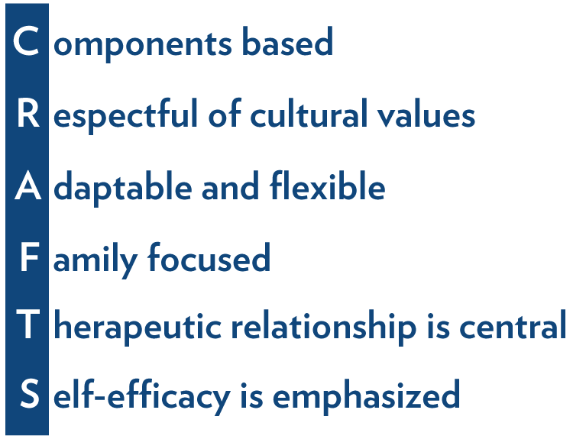
Guiding Principles of TF-CBT
There are several guiding principles that form the foundation of TF-CBT. Most are true of virtually every evidence-based treatment for children. The guiding principles form the acronym CRAFTS.

Slide 23
Guiding Principles of TF-CBT
Taken directly from the TF-CBT materials
1) Components Based
TF-CBT is comprised of a set of treatment components, each of which has a specific therapeutic purpose and set of techniques. Each component builds on the previous one to achieve the therapeutic effect. There is not a specifically prescribed set of procedures for each therapy session. Rather, therapists work through the treatment components in the proper order, utilizing pacing that accommodates to clients’ needs.
2) Respectful of Cultural Values
At all times therapists should be respectful of the culture and values of client families. Procedures and techniques should be adapted as necessary to accommodate cultural norms and values. Research has shown that TF-CBT can be used successfully with children from a wide range of cultural, ethnic, racial, and country of origin backgrounds.

Slide 24
Guiding Principles of TF-CBT
Taken directly from the TF-CBT materials
3) Adaptable and Flexible
TF-CBT treatment components, techniques, and procedures can be adapted to many different clinical settings, situations, and families. The pacing of treatment components is somewhat flexible, and techniques are adaptable for specific families. Therapist creativity in treatment delivery is encouraged, as long as the fundamental goals and principles of each treatment component are followed.
4) Family Focused
TF-CBT is a family treatment. Nearly half of the treatment involves a supportive caregiver being seen conjointly with the child or individually. A key goal of TF-CBT is improving effective parental/caregiver support for the child.

Slide 25
Guiding Principles of TF-CBT
Taken directly from the TF-CBT materials
5) Therapeutic Relationship is Central
As with all effective psychotherapies, developing a strong therapeutic relationship with the child and caregiver is critical in TF-CBT and necessary for client engagement. Research has shown that the quality of the therapeutic relationship is even more important to the success of therapies such as TF-CBT that include skill development procedures and practice activities outside of session.
6) Self-Efficacy is Emphasized
A purpose of TF-CBT is to help traumatized children face up to the traumatic events they have experienced, effectively cope with them, integrate them into their life history, and get on with their lives. Doing so results in a strong sense of self-efficacy. Children completing TF-CBT should develop both a sense of competence because they are no longer overwhelmed by trauma-related problems, and hope for the future because they have learned how to manage other difficulties that may come along.

Slide 26
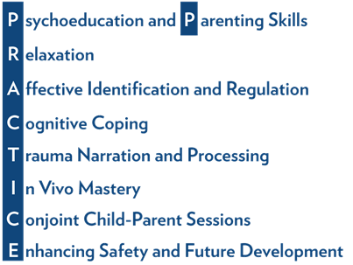
TF-CBT Treatment Components
TF-CBT is comprised of nine treatment components that are captured by the acronym PRACTICE.

Slide 28
In all phases….
…the program provides information about
specific techniques and procedures to use
practice/homework items to give
unique cultural considerations for understanding the client lens and improving engagement
how to share information effectively
developmental considerations by age groups
how to approach child and parent portions of sessions
clinical challenges that may arise

Slide 29
Psychoeducation & Parenting Skills
Emphasis: Provide the child and caregiver with education about the prevalence of abuse or other traumatic events the child may have experienced, normal reactions to abuse and trauma, and the benefits of treatment.
The therapist seeks to instill hope and positive expectations about the outcome of therapy.
Psychoeducation begins treatment and continues throughout the treatment process.

Slide 30
Psychoeducation & Parenting Skills
Administer and review assessment findings (e.g., PTSD, family coping, communication, social skills)
Describe what will happen in the phases of treatment
Take a baseline “trauma narrative”—what can the child share/talk about at the start?
Abuse and trauma—provide general educational info.
Abuse and trauma—specific info about the specific type that happened to them (physical, sexual, witnessed violence, other)
Give info handouts as homework to digest

Slide 31
Relaxation
Teach a set of relaxation skills to both child and caregiver/methods of making the body physiologically relax.
Helps learn to manage the physiological symptoms of fear and anxiety.
Serves to reduce the child’s perceptions of fear and anxiety.
Encourages a sense of empowerment and mastery over symptoms.

Slide 32
Relaxation
Sample techniques
Teach safe and effective exercises to learn to control anxiety and relax.
controlled breathing
Muscle relaxation
Alternative relaxation approaches
Applying strategies outside of the office
In-session role-play strategies to increase understanding about how and when to use relaxation
• Assign homework to practice relaxation without you, e.g., controlled breathing and progressive muscle relaxation recording forms

Slide 33
Affect Identification & Regulation
Experiencing traumatic events can make kids experience intense levels of negative emotions (e.g., sadness, anger, fear, anxiety, guilt, shame, and disgust).
May have difficulties identifying, understanding, expressing, and regulating their feelings, particularly negative feelings.
Caregivers themselves also often experience a range of difficult emotions following a traumatic event, and they may need help learning how to express and regulate their emotions in a healthy manner.

Slide 34
Affect Identification & Regulation
Sample techniques
Explain rationale for identifying feelings
Baseline—help child identify as many feelings as possible
Games, e.g., “feelings charades” to discuss feelings
Teach emotional intensity ratings (self and other)
Teach how to express feelings appropriately in situations that challenge them
Extending from identification to regulation through many techniques

Slide 35
Cognitive Coping
Therapist actions:
Explain the connections between thoughts, feelings, and behavior.
Help the child and caregiver develop the skills to generate alternative thoughts that are more accurate or helpful, in order to feel differently, laying the foundation for later cognitive processing.
In parent sessions, help caregivers explore specific thoughts related to the traumatic event and how they are connected to specific feelings and behaviors.

Slide 36
Cognitive Coping
Sample techniques
Differentiate thoughts vs feelings
Outline the “cognitive triangle” (thoughts, feelings, behavior)
Teach how thoughts affect behavior
Generate and discuss scenarios, identifying thoughts, feelings, and potential or past behaviors
Challenge inaccurate or unhelpful thoughts and stimulate thought replacement (various age-appropriate CBT techniques)
Help child apply this skill to real life
Other extended cognitive coping techniques

Slide 37
Trauma Narration and Processing
Guide child through creation of a narrative describing the traumatic events with a goal of helping them better manage trauma-related thoughts and feelings.
Developing the trauma narrative is a form of gradual exposure therapy that allows the child to experience the negative feelings associated with the trauma in small doses in a safe, controlled environment.
This process allows children to manage the feelings associated with the trauma and incorporate them into their life, rather than avoid them.

Slide 38
Trauma Narration and Processing
The technique in brief
The narrative might be accomplished using a variety of methods to describe the traumatic event(s) and the child’s reactions, including
writing a book
drawing a set of pictures
writing poems
writing songs
Child helps select the format, begins with Table of Contents—drives progress through the narrative

Slide 39
Trauma Narration and Processing
The technique in brief, page 2
Very detailed procedures and techniques for how to
ask and listen, how to repeat, what to write down and how, how to include both thoughts and feelings
elicit memories appropriately
monitor and manage emotional arousal
reinforce the child in appropriate ways
conclude the task in healing and forward-looking ways.
Very detailed procedures for how to read and re-read the narrative, attend to specific details, process the emotions, challenge unhelpful or inaccurate cognitions, use role plays or experiential exercises—to move the child to desensitization and a sense of emotional control.

Slide 40
In Vivo Mastery
Many traumatized kids experience specific, trauma-related fears of things that are not actually dangerous (e.g., rooms in the house).
If those fears persist after the creation of the trauma narrative, in vivo (or “real life,” as opposed to imaginal) exposure activities can be developed to help children overcome these fears.

Slide 41
In Vivo Mastery
Sample techniques
If necessary, provide a rationale
Follow in vivo mastery techniques, e.g.,
gather info about feared situations,
construct a fear hierarchy,
implement the exposure schedule,
repeat and progress
etc.
Goal=mastery over emotional reactions to the memory, ability to control response when triggered

Slide 42
Conjoint Parent-Child Sessions
Virtually all components of TF-CBT involve use of conjoint sessions.
Last couple of sessions focus explicitly on sharing the trauma narrative with the caregiver(s).
Significant caregiver preparation is usually necessary through individual time with them before sharing the narrative.
Must set up for success and ensure that the caregive is supportive when the child shared, and they validate the child’s experience and feelings.

Slide 43
Conjoint Parent-Child Sessions
Sample techniques
Prepare!
Is child ready to share?
Are parents ready to be supportive?
Can both manage personal distress?
Detailed techniques for explaining rationale and structure for conjoint sessions, how to start, how to share, how to listen, facilitating discussion and questions, ending the sessions, helping facilitate feelings and future conversations.
Can go terribly wrong if unsure and unprepared.

Slide 44
Enhancing Safety & Future Development
The final component emphasizes ensuring healthy child and family growth after treatment is over.
Focus of sessions: Enhancing family communication and children’s personal safety skills
Purpose:
to minimize risk for future victimization and
enhance feelings of self-efficacy and self-competence.

Slide 45
Enhancing Safety & Future Development
Sample techniques
Detailed techniques for how to: time conversations about safety-related behaviors, avoid future trauma, acknowledge progress made, involve caregivers, teach how to communicate feelings clearly and openly, practice effective responses to future or ongoing threatening situations, teach how to identify and advocating for safe people and places, teach body ownership, teach how to ask for help.
How and when to end therapy.

Slide 46
TF-CBT Delivery Details
Parent/Caregiver Involvement
A supportive parent or other caregiver (grandparent, aunt/uncle, adult sibling, or foster parents) should be involved in treatment, as well as the child.
All TF-CBT treatment sessions involve both the child and the supportive caregiver.
The structure of sessions varies by treatment component, the age and developmental level of the child, and other factors.
However, most sessions involve individual time working with the child, some time working with the parent/caregiver individually, and some time spent working conjointly with the child and the parent/caregiver.

Slide 47
TF-CBT Delivery Details
Gradual Exposure
Every phase and every session involves some form of psychological exposure to the traumatic event
In each session we review some aspect of the trauma. Examples:
Relaxation—teach general skills first, then apply to the tension related to the traumatic event.
Affect Identification and Regulation--identify trauma-related emotions, then discuss.
Every component of TF-CBT includes discussion of the child’s traumatic experiences and their effects. This helps improve mastery and sets the stage for the successful development and processing of the trauma narrative.
Different than “flooding,” “prolonged exposure,” or other intense methods of remembering and reviewing trauma experiences—do not confuse).

Slide 48
TF-CBT Delivery Details
Session Frequency and Length
Weekly is ideal, 60-90 minutes per session
The treatment can fit into 45-50 min sessions, though, which is common
Can be more frequent (e.g., 2x/week) but disconnected if less than1x/week
Consistency and regularity are critical to build skills
Duration of Treatment
Shown to be effective in as few as 8 sessions and occasionally may extend to as many as 25 sessions.
Most successful within 12-20 sessions.

Slide 49
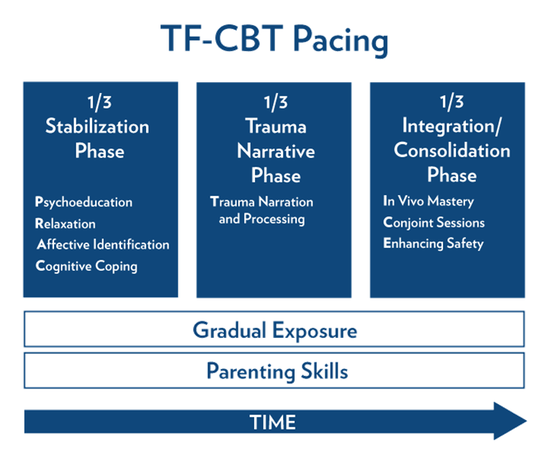
Phases and Pacing of TF-CBT
As you may have noticed—3 sequential treatment phases
1) Stabilization--“PRAC” components, including both P components. About 1/3 of sessions.
2) Trauma Narrative—”T” alone. Major focus is gradual exposure, as children and caregivers process their reactions to the child’s narrative. About 1/3 of sessions.
3) Integration/Consolidation—”ICE”
Continue with In Vivo Mastery of things that remind about the trauma and trigger. About 1/3 of sessions.

Slide 50
In all phases of TF-CBT
Include the Parenting Skills component in all phases and sessions, to help caregivers manage child behavior, as needed.
Gradual exposure to the trauma, in one form or another, should be a part of every component and every session of TF-CBT.
In PRAC components, applying newly learned skills to trauma-related symptoms or situations is most common.
In other components, the trauma is discussed more directly and naturally.

Slide 51
Treatment Settings
Usually in traditional office settings.
Can also work in schools, homes, residential treatment, and even in refugee camps.
Fidelity to the treatment model is most critical, more than setting or environment.

Slide 52
Treatment Fidelity
Just like any EBI (evidence-based intervention), have to skillfully deliver the model as designed.
Necessary in order to achieve the positive treatment effects intended.
Generally, higher fidelity to the model >> better outcomes of treatment.
Treatment fidelity has two components:
Adherence
Competence

Slide 53
Therapist Adherence to the Model
Conduct TF-CBT as developed and tested.
Important points of adherence to the model:
Use with appropriate cases (exposure to trauma—one or more event, and clinically meaningful PTSD symptoms because of it) (slides 17-20)
Involve a supportive parent/caregiver in all components and sessions.
Hold sessions weekly or more frequently
Follow the PRACTICE components
Allocate time 1/3, 1/3, 1/3 on the three phases
Complete treatment in 12-20 sessions

Slide 54
Therapist Competence on the Model
A key part of competence is correct implementation of procedures and techniques as designed!
Each component requires knowledge and clinical skill to deliver effectively.
Learning the knowledge and skills, and practicing them (ideally, with knowledgeable supervision at first), is how to become competent in applying these procedures.

Slide 55
Measuring Fidelity and Outcomes
Therapists must pay close attention to their adherence
Do so on regular basis as part of their treatment delivery, esp when just learning.
Assess treatment outcomes regularly. This includes:
prior to beginning treatment
during treatment, and
at the end of treatment.

Slide 56
Empirical Support/Research
Taken directly from TF-CBT materials
TF-CBT has been tested in multiple (more than 20) randomized controlled trials. Studies have been conducted with children as young as 3 and as old as 18 who have experienced many different types of traumatic events. Studies have compared the impact of TF-CBT to both passive and active treatments. Many of these studies were done by the treatment developers, but many have been performed by researchers who had nothing to do with developing the treatment. Initially, studies involved children living in the U.S., but many more recent studies have been conducted in countries other than the U.S., including Australia, Norway, Congo, and Zambia. In all of these studies, TF-CBT has been found to be an effective treatment with children and families from diverse cultural and ethnic backgrounds. TF-CBT received the highest rating for effectiveness from several independent rating programs (e.g., California Evidence-Based Clearinghouse for Child Welfare, the OVC Guidelines Project, and the National Registry of Evidence-based Programs and Practices).

Slide 57
Empirical Support/Research
TF-CBT is the most rigorously tested treatment for traumatized children and non-offending caregivers
More than 20 randomized trials.
Improved child PTSD, depression, anxiety, shame and behavior problems compared to supportive treatments.
Improved caregiver distress, caregiver support, and caregiver depression compared to supportive treatment.
Previous outcome studies included diverse ethnic and racial samples, e.g.,
Sexually abused youth from Latina/o and African/Caribbean descent found it acceptable, feasible, and efficacious.

Slide 58
The National Child HELP Partnership
Extensive data collection taken from both the child and the caregiver.
Entered into a national database, anonymously.
Analyzed in aggregate
As part of the $3M grant to Dr. Elissa Brown at St. John’s University

Slide 59
Revisiting Intervention Options
This is an individual technique.
How can you use it as an individual mental health advocate/change agent?
What do you think we could/should do in schools?
Are there systemic implications? How?

Slide 60
Thank you!
Questions? Ideas? Interested in learning more?
Please feel free to contact me with any questions or ideas, and/or see more detail
about my past and current academic, research, and service/outreach work:
Cheryl L. Somers, Ph.D.
cell: 313-516-5600
c.somers@wayne.edu
cheryl.somers2010@gmail.com
https://education.wayne.edu/profile/ae8865
https://www.detroits3lab.org/
https://www.monarchroom-traumainformededucation.com
https://education.wayne.edu/health-community-impact
https://www.michiganselalliance.org/

